Slide 1
Topic
Presentation on Full Stack Project
MindWhisper - MENTAL HEALTH GENERAL AND CHATBOT
by
G-24
Arushika: 2310990301
Vishal Mishra: 2310991363
Muskan: 2310991416
Nandini Sharma: 2310991420
Supervised by: Mr. Rahul Singh Rajput
Department of Computer Science and Engineering, Chitkara University, Punjab

Slide 2
Table of Contents
Problem Statement
Objective / Purpose
Main Topics / Sections (Depends on your topic)
Future Scope
Conclusion
References (if applicable)
Q&A / Discussion

Slide 3
Problem Statement
Mental health issues such as stress, anxiety, and depression are becoming increasingly common, especially among students and young professionals. However, many individuals hesitate to seek help due to stigma, lack of awareness, or limited access to mental health professionals.
Traditional counseling services are not always accessible 24/7, and in many regions, there is a shortage of trained mental health practitioners. This leaves individuals without timely support during critical moments.
There is a need for a readily available, user-friendly, and supportive platform that can provide:
A safe space for users to express their thoughts.
Basic guidance, coping strategies, and mental wellness resources.
Immediate assistance in non-critical situations, while encouraging professional help when necessary.

Slide 4
Objective / Purpose
Enhance Mental Health Awareness: Provide an accessible platform where individuals can openly discuss their concerns, reducing stigma and promoting early intervention.
Offer AI-Powered Support: Deliver empathetic and real-time chatbot conversations, offering coping strategies, mindfulness exercises, and guidance to manage stress, anxiety, and related challenges.
Ensure User-Friendly Experience: Build a seamless and engaging interface with smooth navigation, personalized recommendations, and secure interactions for all users.
Promote Community Engagement: Create a safe, supportive network by integrating forums, volunteer interactions, and peer-to-peer support opportunities.
Collaborate with Professionals: Integrate expert resources, helplines, and professional guidance to ensure users receive credible and diverse support.
Overall Goal: Establish the chatbot as a reliable, inclusive, and innovative platform for mental well-being — making mental health support accessible, personalized, and engaging for everyone, anytime and anywhere.

Slide 5
Main Topics / Sections
User-Centric Design
Responsive Interface: Built with React to provide a seamless experience across all devices.
Enhanced User Experience: Prioritizes intuitive layouts, fast load times, and smooth interactions to create a stress-free mental health support environment
.
2. Efficient Backend Architecture
Scalable and Real-Time Operations: Developed using Node.js and Express.js to support real-time chats, instant support, and seamless interactions.
Secure Data Handling: Uses MongoDB for safe storage of user profiles, chat history, and preferences with authentication and encryption.
3. Chatbot and AI-Powered Assistance
24/7 Conversational Support: Empathetic chatbot offering guidance on stress, anxiety, and emotional well-being.
AI Recommendations: Personalized suggestions such as mindfulness exercises, coping strategies, and motivational content.

Slide 6
Main Topics / Sections
4. Advanced Features Implementation
Dynamic Filtering & Sorting: Users can explore curated mental health resources (articles, videos, music, exercises) with category-based filters.
Saved Resources & Personalized Recommendations: Users can bookmark helpful content and receive suggestions based on their past interactions.
5. Expert and Community Collaboration
Consultant & Volunteer Portal: Integration for professionals and volunteers to share insights, offer guidance, and track interactions.
Issue Resolution System: Admin panel for monitoring reported issues and resolving user concerns efficiently.
6. Robust Testing and Deployment
Comprehensive Testing: Ensures scalability, security, and smooth performance across different devices and environments.
Continuous Monitoring & Updates: Regular improvements based on user feedback to enhance accessibility and usability.

Slide 7
Future Scope
Enhanced Mental Wellness Resources
Expand access to mental health content by integrating a diverse range of self-help books, guided meditation tracks, and expert-led video sessions.
Introduce real-time content updates to ensure users always have access to the latest
wellness resources.
Personalized Support Programs
Offer tailored wellness plans, including curated self-care routines and guided mental health exercises.
Provide exclusive access to premium features such as one-on-one therapy sessions,
mindfulness workshops, and expert Q&A forums.
AI-Powered Mental Health Assistants
Develop AI-driven mental health assistants to help users track moods, receive personalized coping strategies, and navigate available resources.
Provide real-time guidance for stress management, emotional well-being, and mindfulness techniques.

Slide 8
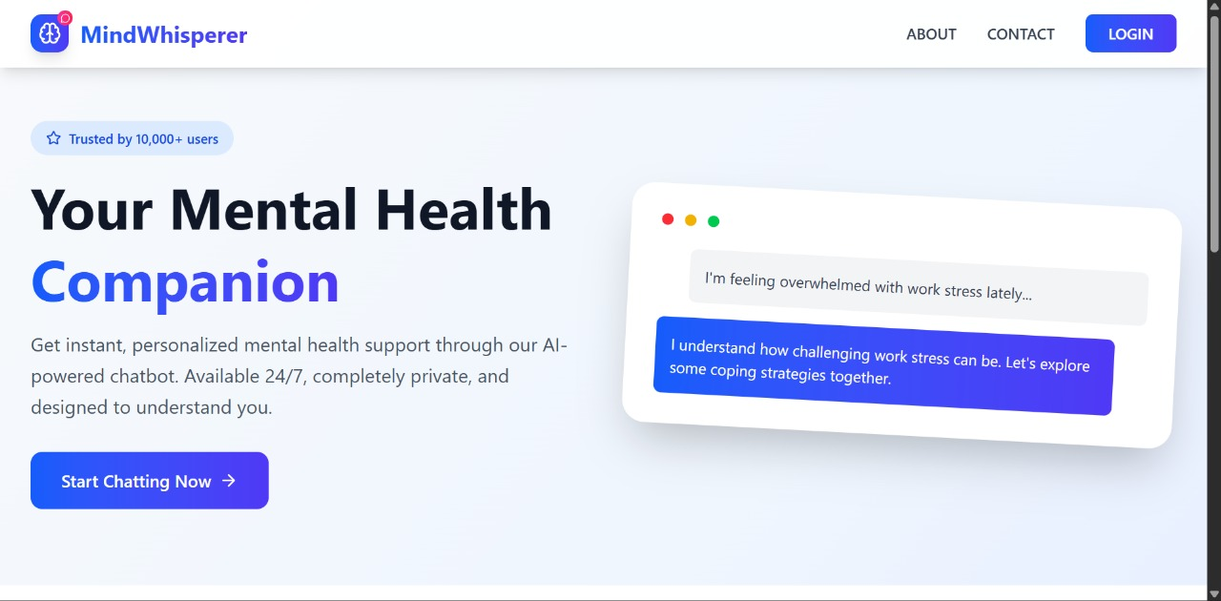
Project Snippets

Slide 9
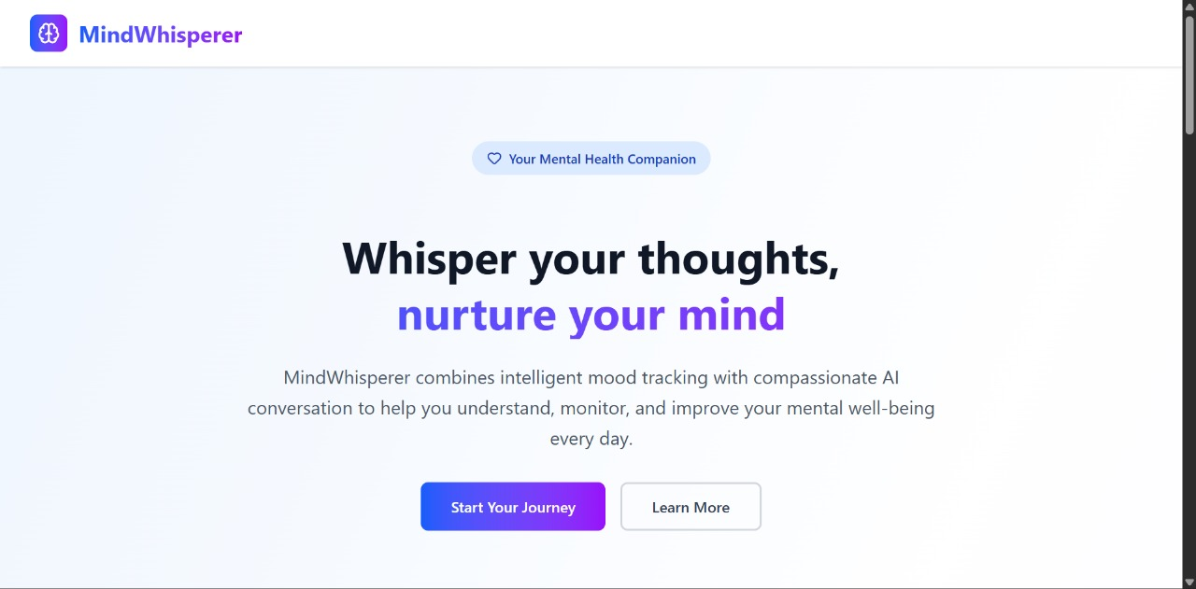
Project Snippets

Slide 10
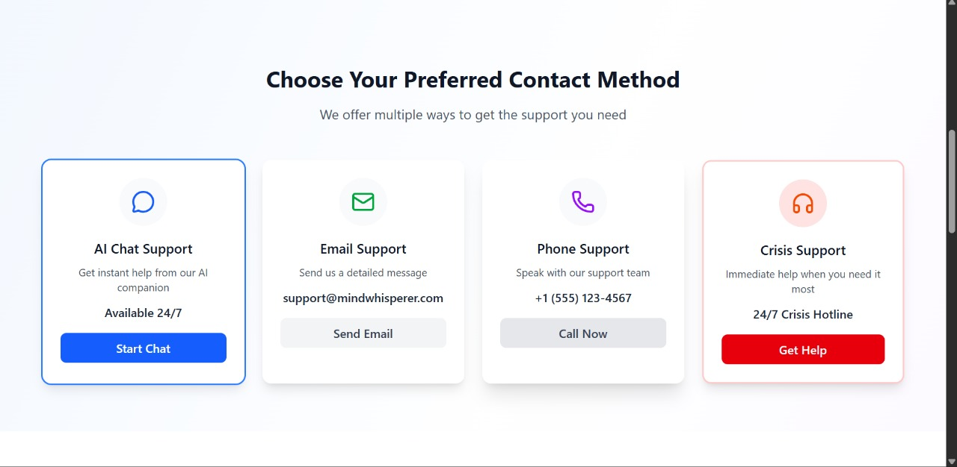
Project Snippets

Slide 11
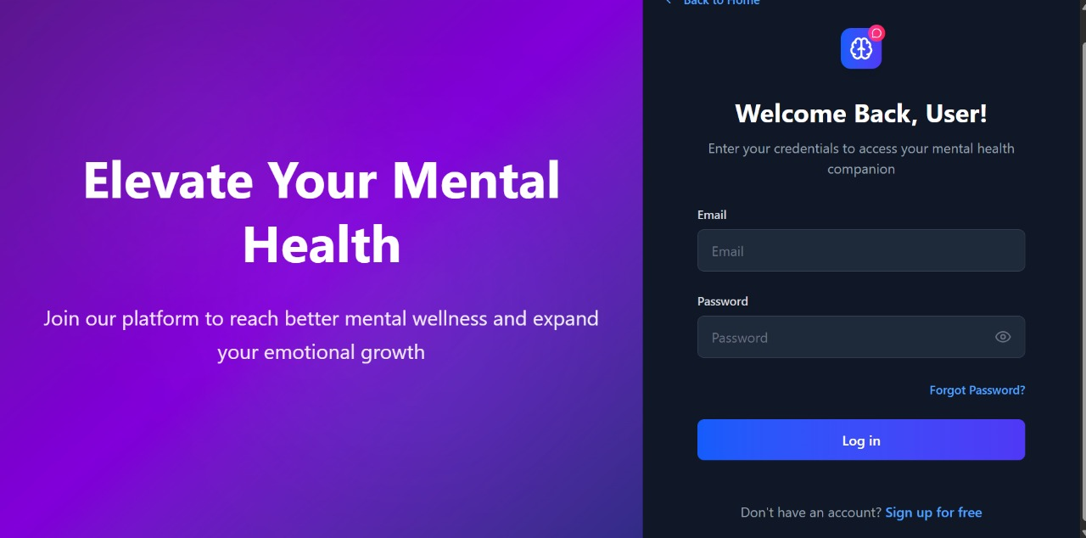
Project Snippets

Slide 12
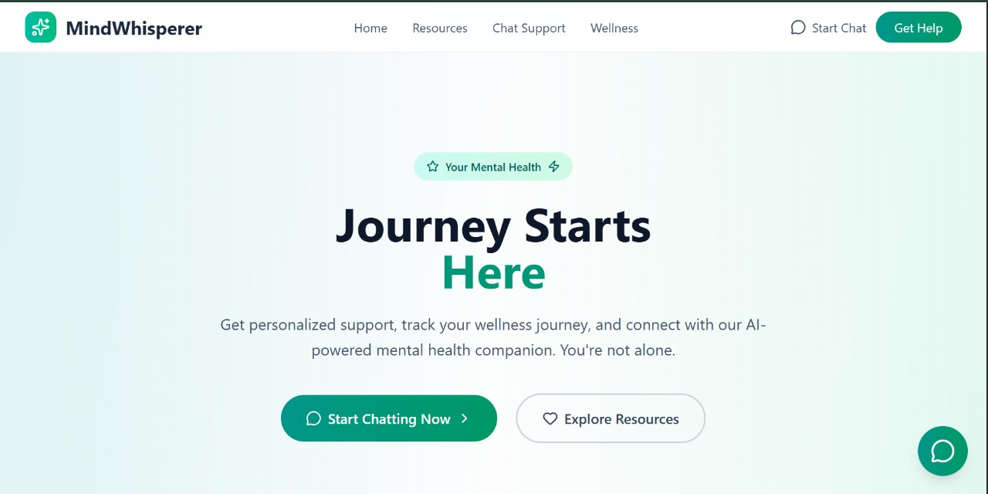
Project Snippets

Slide 13
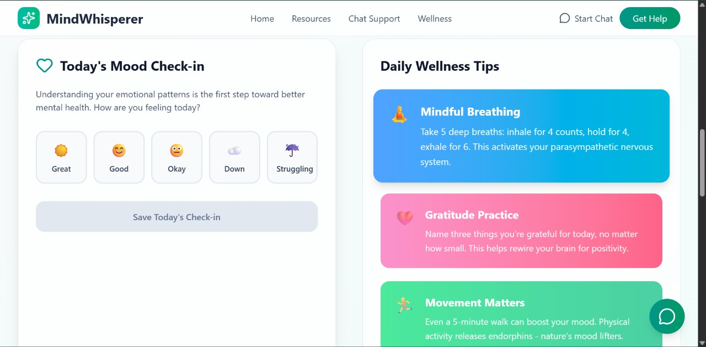
Project Snippets

Slide 14
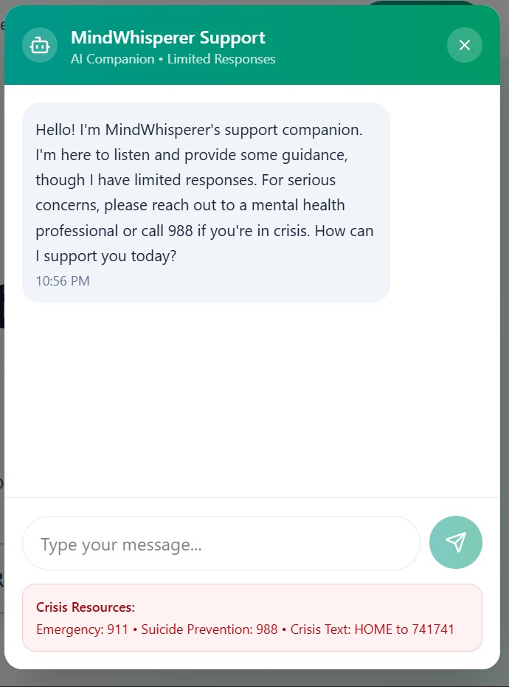
Project Snippets

Slide 15
Conclusion
Developed a mental health chatbot using the MERN stack for accessible and user-friendly support.
Provides real-time chat assistance, basic coping strategies, and mental wellness resources.
Ensures secure authentication and safe data handling for users.
Offers an intuitive, responsive interface for stress-free interaction.
Acts as a first step toward mental health awareness, not a replacement for professional therapy.
Demonstrates potential for future integration with AI models, mobile apps, and professional collaborations.
Promotes accessible, inclusive, and empathetic mental health support for all users.

